Slide 1
Fluid Simulator
도토리는버스둘태워야서로맛

Slide 2
To do list
Fluid
Fluid simulation
Collision with obstables
Fluid rendering
Model
Modeling
Texture mapping, normal mapping
Ambient occlusion / Shadow

Slide 3
Fluid Simulation!
Much better than the previous result

Slide 4
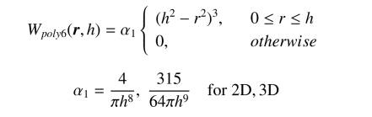
SPH!!
Now ask me why
Based on physically correct “soft particle hydrodynamics”
Scatter-and-gather method.
-> Each particle is a sampling point as well as physical quantity

Slide 5
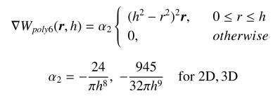
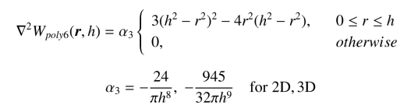
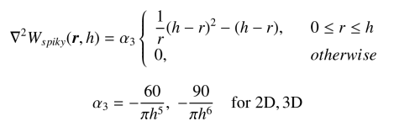
SPH…
Need some calculus
I don’t even know exactly what it is.

Slide 6
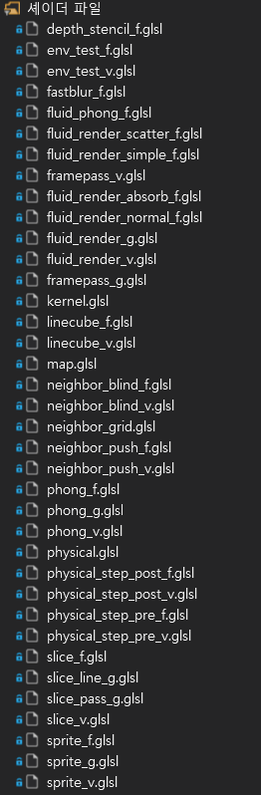
Particle-based simulation
Implement using GLSL.
Total 37 shaders…….
Using texture space to represent each particle
Position, Velocity, Pressure, Density, and so on…
Nothing can be represented easily…

Slide 7
No O(n^2)!
Need neighbor finding algorithm
What we skipped last presentation

Slide 8
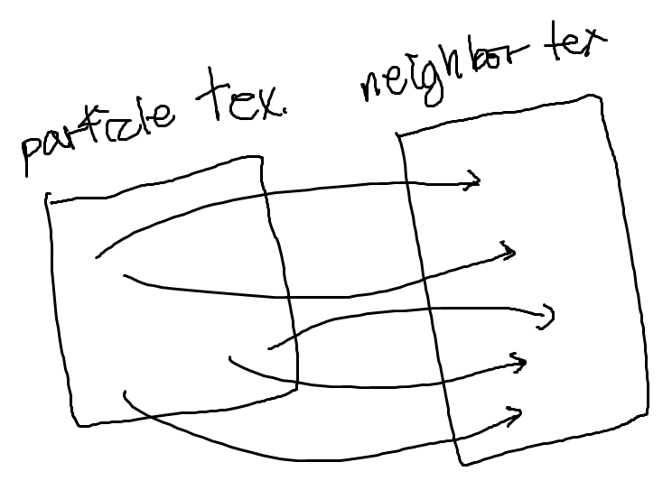
Neighbor Group Finding
It is very easy implementing with CPU
But the world of GPU is soooooooo weird…
Vertex texture fetch
Neighbor group is also a texture
Let particles to draw their “id” according to their physical position

Slide 9
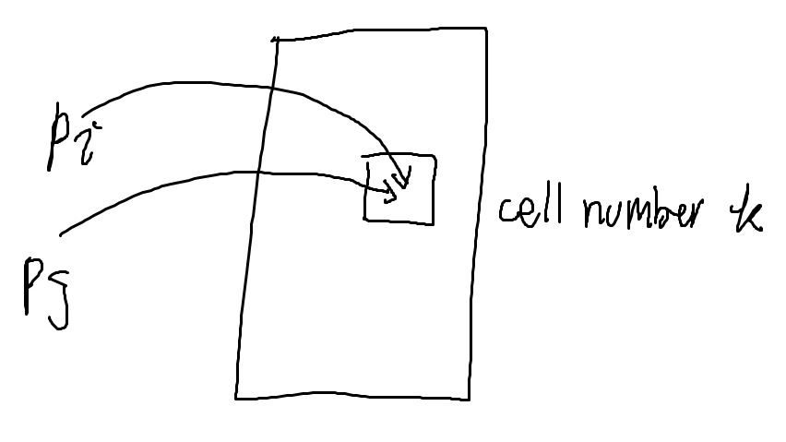
But they collide…
There should be two or more particles that are belong to the same neighbor cell
One will overwrite others

Slide 10
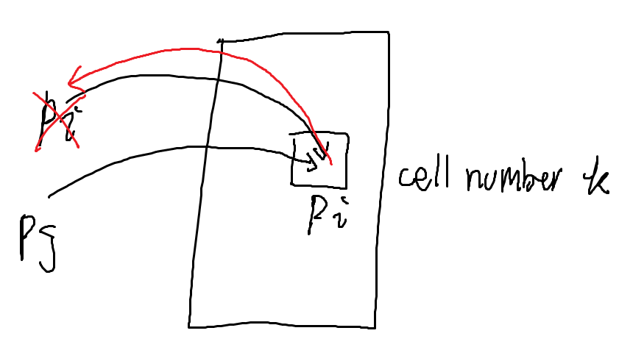
Blind them!
Now neighbor cells draw on particle texture according to their particle “id”
Corresponding particles are “blinded”
They cannot draw their “id”anymore

Slide 11
Neighbor cell with N length
Repeat above procedure N times.
N is a trade-off value between accuracy and performance.

Slide 12
Collision with static object
Veeeeeeeeeeeerryyyyy nasty to use naive vertex information
It will be terribly slow

Slide 13
3D texture
Store environment data into 3D texture (render on it) and use it as a vector field
Slice 3d model along z-axis and store them into 3D texture.
Caution! Perpendicular planes are not drawn.
-> solved with geometry shader
Nice.

Slide 14
Pretty fluid
It moves like water
But not looks like water

Slide 15
Pretty fluid
Cheap optical approximation
Light absorption
Scattering
Phong shading on surface
Finding surface?

Slide 16
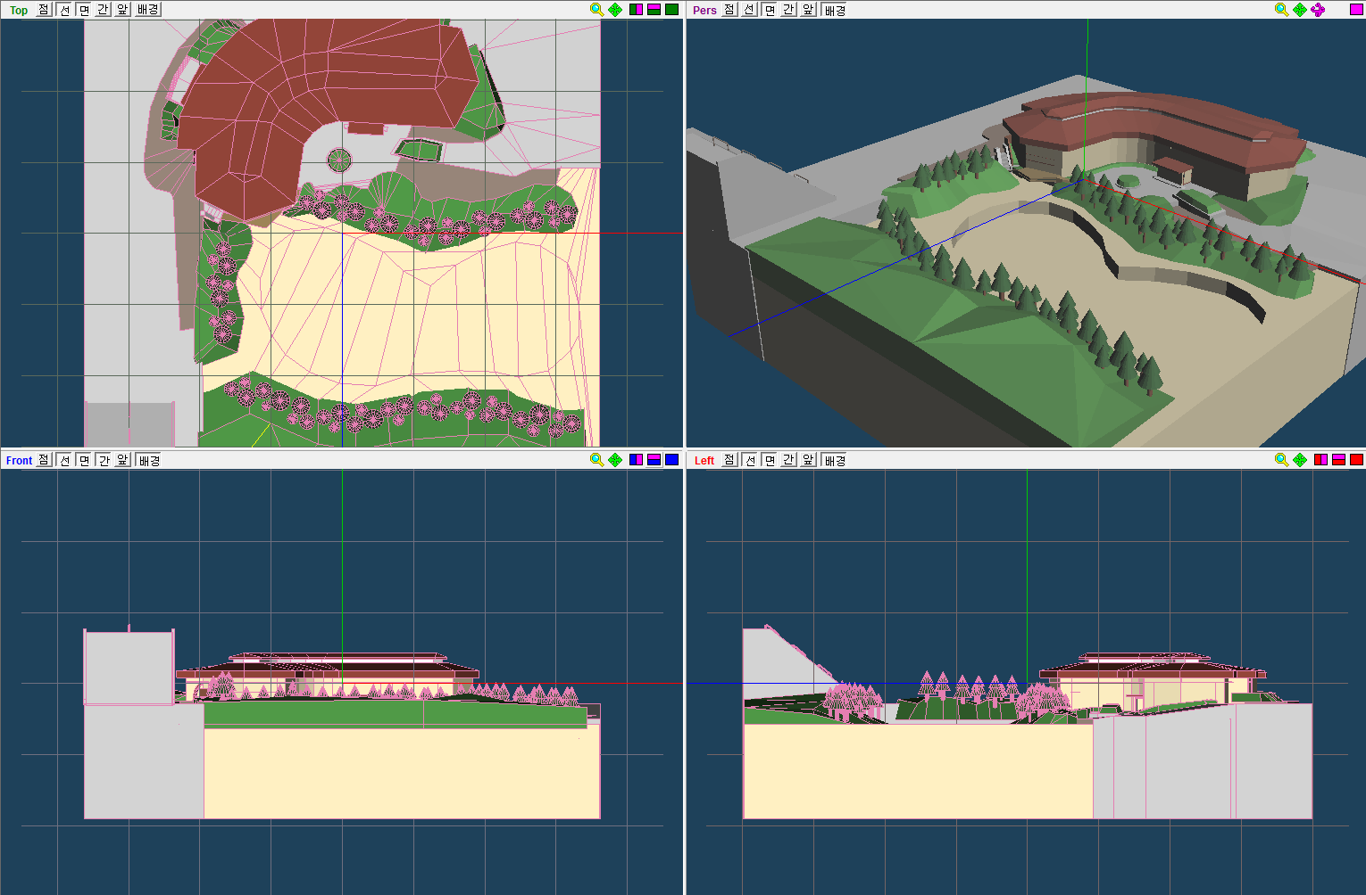
Modeling

Slide 17
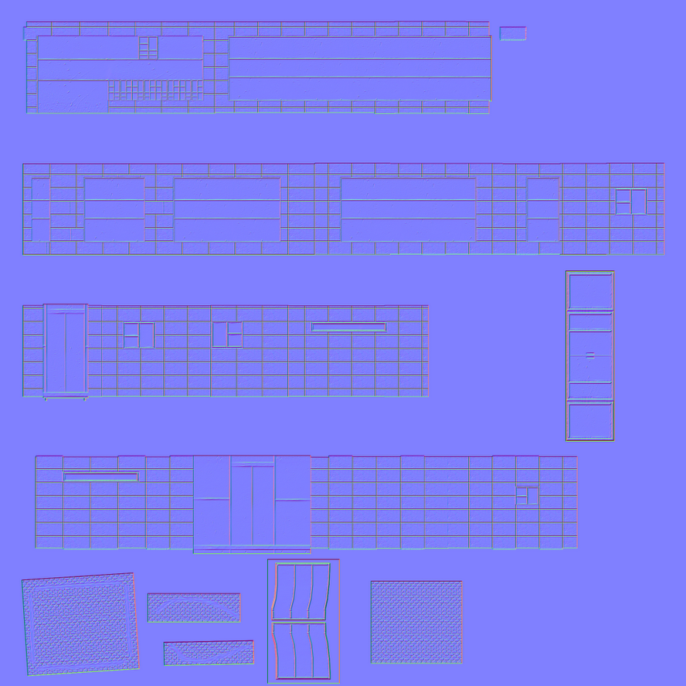
Mapping

Slide 18
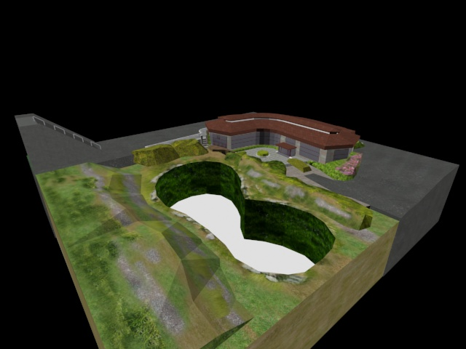
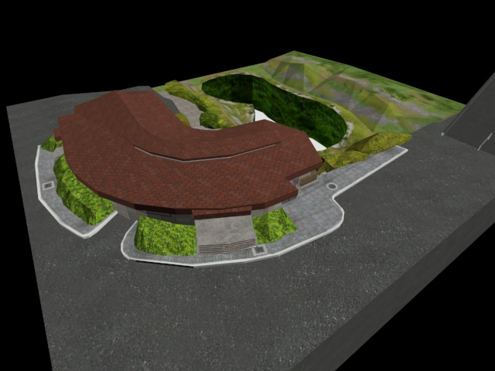
Modeling + Mapping

Slide 19
Demo
Lets go

Slide 20

Thank you

